Slide 1
Modeling in Federated Graph Neural Networks: Overview and Techniques
①
②
③
Handling distributed coupled graphs while ensuring privacy and security.
Decentralized Graph Data Processing
Addressing domain heterogeneity with clustering and graph networks.
Sharing structural knowledge to handle non-IID graph data
Domain-aware Federated Learning
⑤
④
Improving model performance with global self-supervision.
Reducing overhead and privacy risks with intelligent graph sampling
Cross-client Knowledge Sharing
Global Knowledge Integration
CPS Computational Learning Laboratory
1

Slide 2
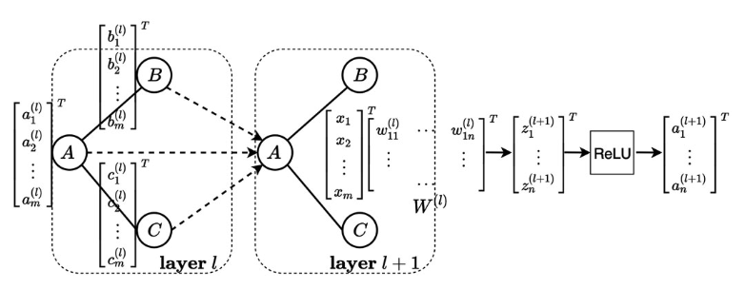
Graph convolutional network
Fig: Illustration of graph convolution operation.
Graph convolutional network (GCN) considers an undirected graph defined as $G=(V, E)$, where sets $V$ and $E$ include nodes and edges, respectively. The corresponding graph adjacency matrix is denoted by $A$.
CPS Computational Learning Laboratory
2

Slide 3
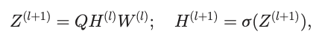
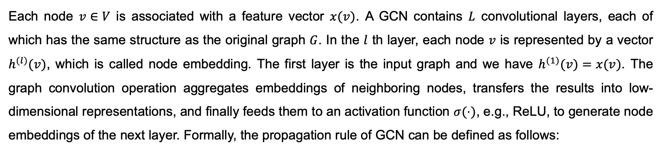
Graph convolutional network
Fig: Illustration of graph convolution operation.
Each node $v∈V$ is associated with a feature vector $x(v)$. A GCN contains $L$ convolutional layers, each of which has the same structure as the original graph $G$. In the $l$ th layer, each node $v$ is represented by a vector $h^{(l)}(v)$, which is called node embedding. The first layer is the input graph and we have $h^{(1)}(v)=x(v)$. The graph convolution operation aggregates embeddings of neighboring nodes, transfers the results into low-dimensional representations, and finally feeds them to an activation function $σ(⋅)$, e.g., ReLU, to generate node embeddings of the next layer. Formally, the propagation rule of GCN can be defined as follows:
CPS Computational Learning Laboratory
3

Slide 4
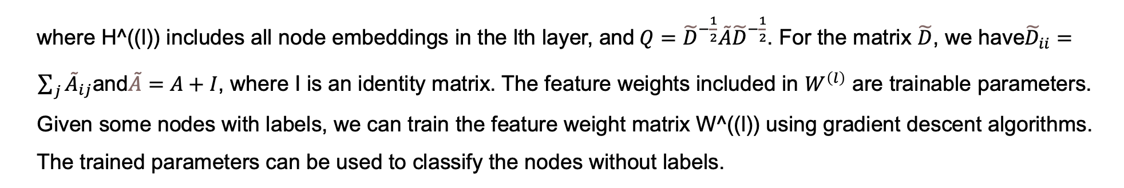
Graph convolutional network
Fig: Illustration of graph convolution operation.
where H^((l)) includes all node embeddings in the lth layer, and$Q={\tilde{D}}^{−\frac{1}{2}}\tilde{A}{\tilde{D}}^{−\frac{1}{2}}$. For the matrix $\tilde{D}$, we have${\tilde{D}}_{ii}= \sum_{j}{{\tilde{A}}_{ij}}$and$\tilde{A}=A+I$, where I is an identity matrix. The feature weights included in $W^{\left(l\right)}$ are trainable parameters. Given some nodes with labels, we can train the feature weight matrix W^((l)) using gradient descent algorithms. The trained parameters can be used to classify the nodes without labels.
CPS Computational Learning Laboratory
4

Slide 5
Modeling in Federated Graph Neural Networks: Overview and Techniques
①
②
③
Handling distributed coupled graphs while ensuring privacy and security.
Decentralized Graph Data Processing
Addressing domain heterogeneity with clustering and graph networks.
Sharing structural knowledge to handle non-IID graph data
Domain-aware Federated Learning
⑤
④
Improving model performance with global self-supervision.
Reducing overhead and privacy risks with intelligent graph sampling
Cross-client Knowledge Sharing
Global Knowledge Integration
CPS Computational Learning Laboratory
5

Slide 6

Paper 1
Federated Learning Over Coupled Graphs
Runze Lei , Pinghui Wang, Junzhou Zhao, Lin Lan , Jing Tao, Chao Deng, Junlan Feng, Xidian Wang, and Xiaohong Guan
Publish Journal: IEEE Transactions on Parallel and Distributed Systems
Published Time: 30 January 2023
IF: 5.4
CPS Computational Learning Laboratory
6

Slide 7
01
Problem Description
02
Method Design
03
Experiment Results
Contents
04
Future Work
CPS Computational Learning Laboratory
7

Slide 8
01
Problem Description
02
Method Design
03
Experiment Results
Contents
04
Future Work
CPS Computational Learning Laboratory
8

Slide 9
Problem Description
Traditional FL methods are designed for Euclidean data and need help with graph data due to its non-IID nature and complex topological structure.
The challenge arises in maintaining graph structure and handling interconnections between different subgraphs, essential for accurate tasks like node classification and link prediction.
Existing FL methods on graphs often ignore inter-edges, which are crucial for understanding relations between subgraphs.
CPS Computational Learning Laboratory
9

Slide 10
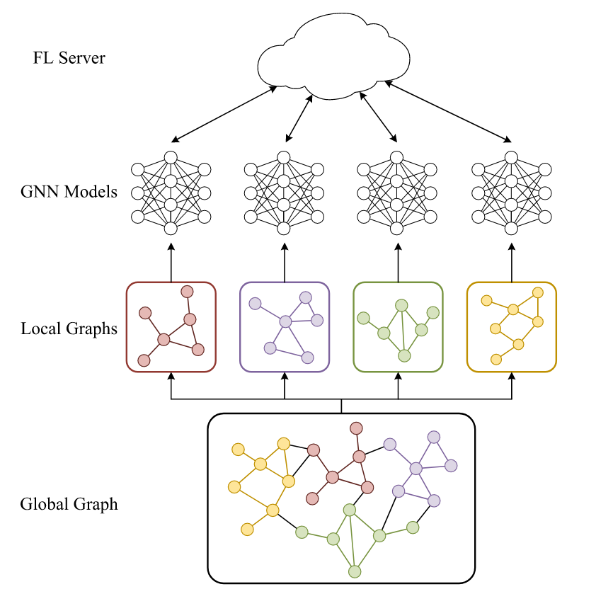
Problem Description
Each FL party possesses a subgraph of the global graph.
A portion of topological information on the global graph is missing on the local graphs.
Some edges on the global graph connect nodes held by different FL parties, so none of the parties can utilize these edges when training.
Fig: The general structure of federated learning on distributed graph data.
CPS Computational Learning Laboratory
10

Slide 11
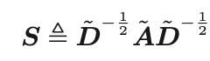
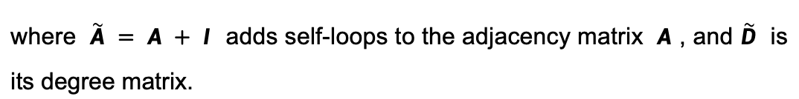
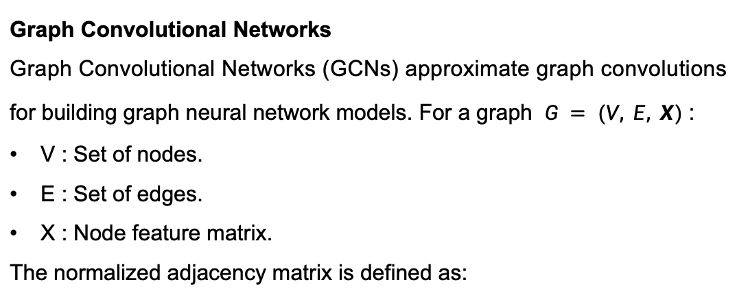
Problem Description
Graph Convolutional Networks
Graph Convolutional Networks (GCNs) approximate graph convolutions for building graph neural network models. For a graph $G = (V, E, X)$:
V : Set of nodes.
E : Set of edges.
X : Node feature matrix.
The normalized adjacency matrix is defined as:
where $\tilde{A} = A + I$ adds self-loops to the adjacency matrix $A$ , and $\tilde{D}$ is its degree matrix.
Fig: The general structure of federated learning on distributed graph data.
CPS Computational Learning Laboratory
11

Slide 12
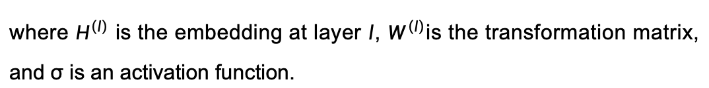
Problem Description
Graph Convolutional Networks
GCNs update node embeddings through:
where $H^{\left(l\right)}$ is the embedding at layer $l$, $W^{\left(l\right)}$is the transformation matrix, and σ is an activation function.
Fig: The general structure of federated learning on distributed graph data.
CPS Computational Learning Laboratory
12

Slide 13
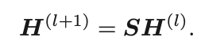
Problem Description
Simple Graph Convolution
Simple Graph Convolution (SGC) removes non-linearities in GCNs. The node embedding update becomes:
Fig: The general structure of federated learning on distributed graph data.
CPS Computational Learning Laboratory
13

Slide 14
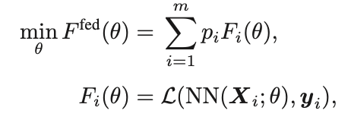
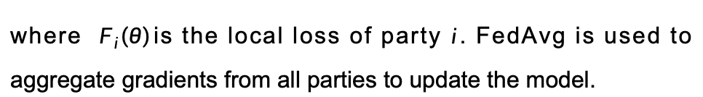
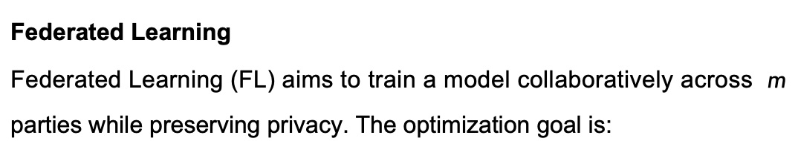
Problem Description
Federated Learning
Federated Learning (FL) aims to train a model collaboratively across $m$ parties while preserving privacy. The optimization goal is:
where $F_{i}\left(θ\right)$is the local loss of party $i$. FedAvg is used to aggregate gradients from all parties to update the model.
Fig: The general structure of federated learning on distributed graph data.
CPS Computational Learning Laboratory
14

Slide 15
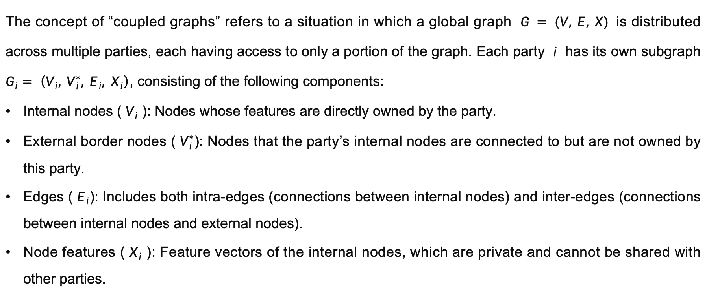
Problem Description
Coupled Graphs
The concept of “coupled graphs” refers to a situation in which a global graph $G = (V, E, X)$is distributed across multiple parties, each having access to only a portion of the graph. Each party $i$ has its own subgraph $G_{i}= \left(V_{i}, V_{i}^{∗}, E_{i}, X_{i}\right)$, consisting of the following components:
Internal nodes ( $V_{i}$ ): Nodes whose features are directly owned by the party.
External border nodes ( $V_{i}^{∗}$): Nodes that the party’s internal nodes are connected to but are not owned by this party.
Edges ( $E_{i}$): Includes both intra-edges (connections between internal nodes) and inter-edges (connections between internal nodes and external nodes).
Node features ( $X_{i}$ ): Feature vectors of the internal nodes, which are private and cannot be shared with other parties.
CPS Computational Learning Laboratory
15

Slide 16
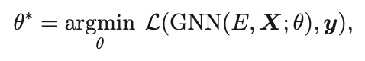
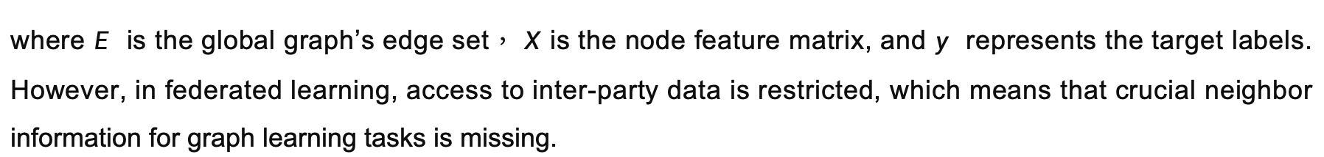
Problem Description
Federated Learning on Coupled Graphs
Federated Learning (FL) on coupled graphs aims to enable multiple parties to jointly train a model using their local graph data while respecting data privacy. In traditional FL, local losses are independent, and each party can compute its gradients. However, in the context of coupled graphs, the interdependence of nodes and edges between parties makes this more complex. The ideal global model for coupled graphs would minimize the loss function:
where $E$ is the global graph’s edge set， $X$ is the node feature matrix, and $y$ represents the target labels. However, in federated learning, access to inter-party data is restricted, which means that crucial neighbor information for graph learning tasks is missing.
CPS Computational Learning Laboratory
16

Slide 17
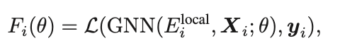
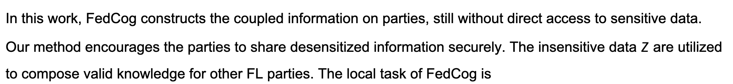
Problem Description
Federated Learning on Coupled Graphs
This disconnection in the graph leads to a different local optimization task:
where $E_{i}^{local}$consists of only the intra-edges within each party‘s local graph.
In this work, FedCog constructs the coupled information on parties, still without direct access to sensitive data. Our method encourages the parties to share desensitized information securely. The insensitive data $Z$ are utilized to compose valid knowledge for other FL parties. The local task of FedCog is
where $Z_{j →i}$represents external data from party $j$ to $i$.
CPS Computational Learning Laboratory
17

Slide 18
01
Problem Description
02
Method Design
03
Experiment Results
Contents
04
Future Work
CPS Computational Learning Laboratory
18

Slide 19
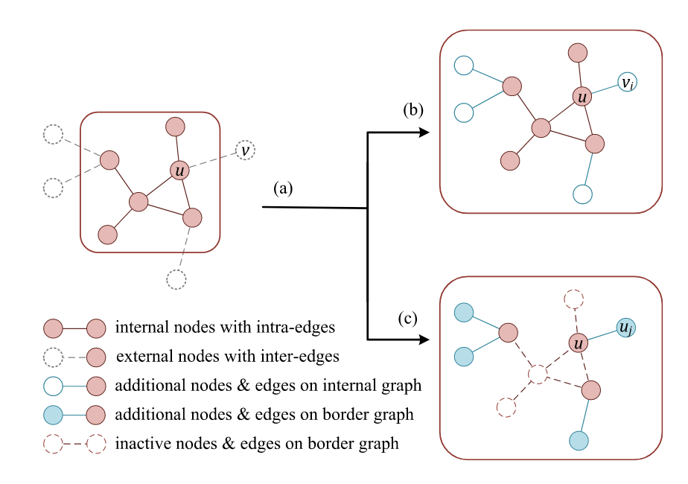
Method Design
FedCog efficiently handles coupled graphs, where the inter-edges between different parties are critical for graph learning tasks.
Fig: Graph decoupling of FedCog
CPS Computational Learning Laboratory
19

Slide 20
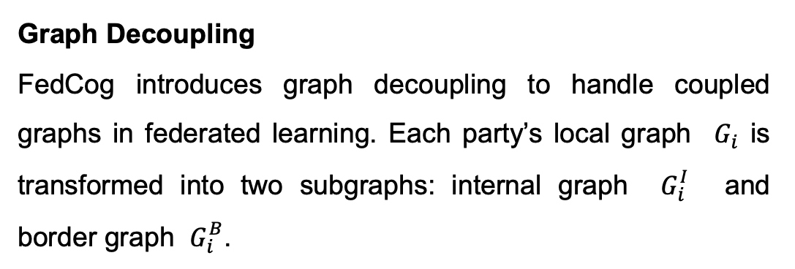
Method Design
Graph Decoupling
FedCog introduces graph decoupling to handle coupled graphs in federated learning. Each party’s local graph $G_{i}$ is transformed into two subgraphs: internal graph $G_{i}^{I}$ and border graph $G_{i}^{B}$.
Internal Graph: Includes the party’s internal nodes and features, along with additional nodes representing external connections.
Border Graph: Contains only inter-edges and connects internal nodes to external nodes from other parties.
Fig: Graph decoupling of FedCog
This decoupling allows parties to share abstracted information without exposing sensitive data.
CPS Computational Learning Laboratory
20

Slide 21
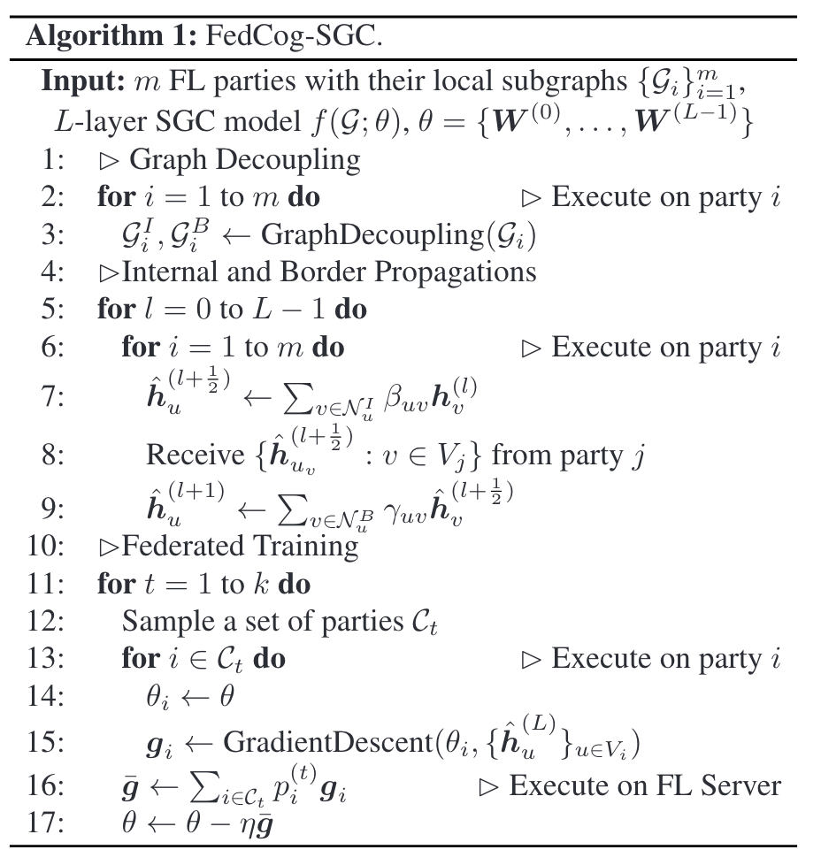
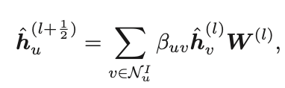
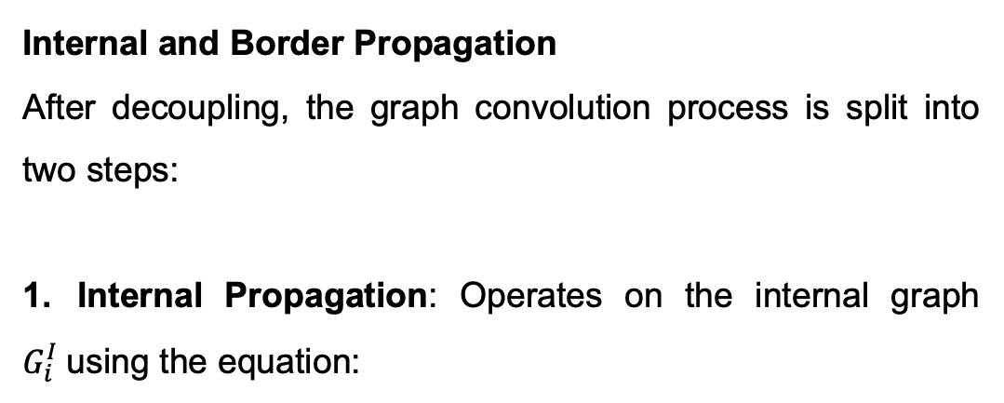
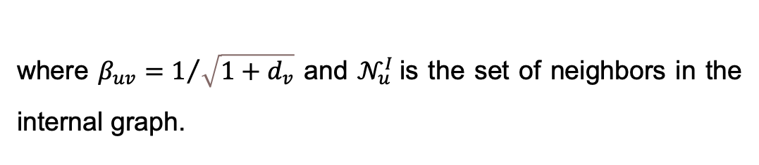
Method Design
Internal and Border Propagation
After decoupling, the graph convolution process is split into two steps:
1. Internal Propagation: Operates on the internal graph $G_{i}^{I}$using the equation:
where $β_{uv}=1/{\sqrt{1+d_{v}}}$ and $𝒩_{u}^{I}$is the set of neighbors in the internal graph.
CPS Computational Learning Laboratory
21

Slide 22
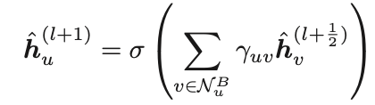
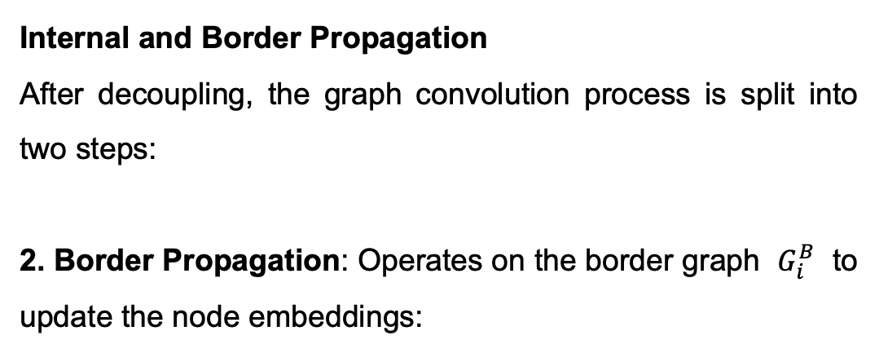
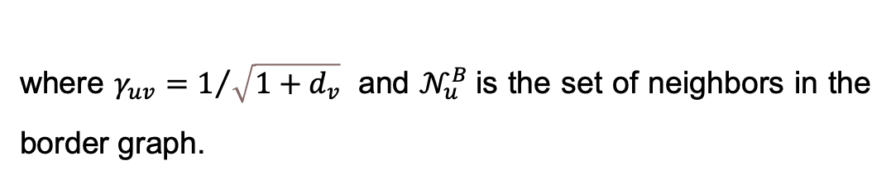
Method Design
Internal and Border Propagation
After decoupling, the graph convolution process is split into two steps:
2. Border Propagation: Operates on the border graph $G_{i}^{B}$ to update the node embeddings:
where $γ_{uv}=1/{\sqrt{1+d_{v}}}$ and $𝒩_{u}^{B}$is the set of neighbors in the border graph.
CPS Computational Learning Laboratory
22

Slide 23
Method Design
Federated Training
FedCog uses federated training to update model parameters securely:
Each party performs local training using the decoupled graphs.
The gradients are securely aggregated using methods like FedAvg:
where $Z_{j →i}$represents external data from party $j$ to $i$.
FedCog ensures privacy by only sharing intermediate representations, not raw data. The local nearest neighbor connection is used to avoid privacy leakage by adding intra-edges to nodes without internal neighbors.
CPS Computational Learning Laboratory
23

Slide 24
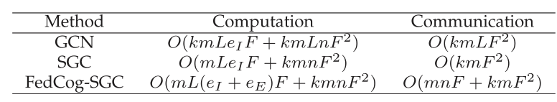
Method Design
Table: Costs of Graph Fl Methods
CPS Computational Learning Laboratory
24

Slide 25
01
Problem Description
02
Method Design
03
Experiment Results
Contents
04
Future Work
CPS Computational Learning Laboratory
25

Slide 26
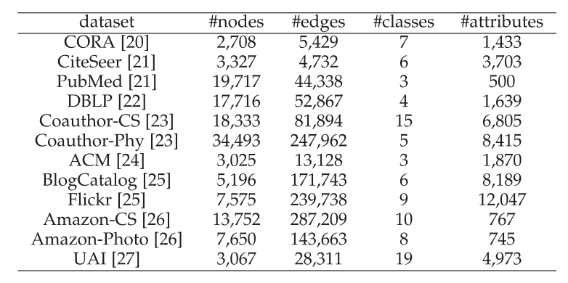
Experiment Results
Table: Summary of Real-world Datasets
CPS Computational Learning Laboratory
26

Slide 27
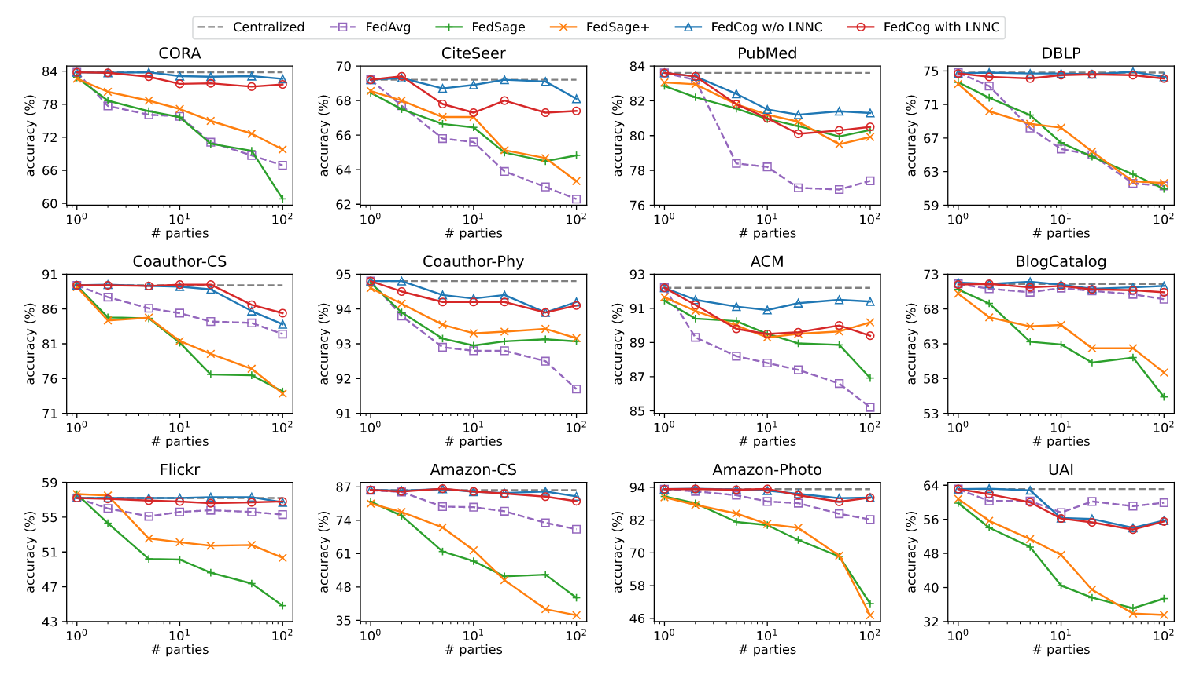
Experiment Results
Fig: Node classification accuracy when the global graphs are partitioned by K-Means.
CPS Computational Learning Laboratory
27

Slide 28
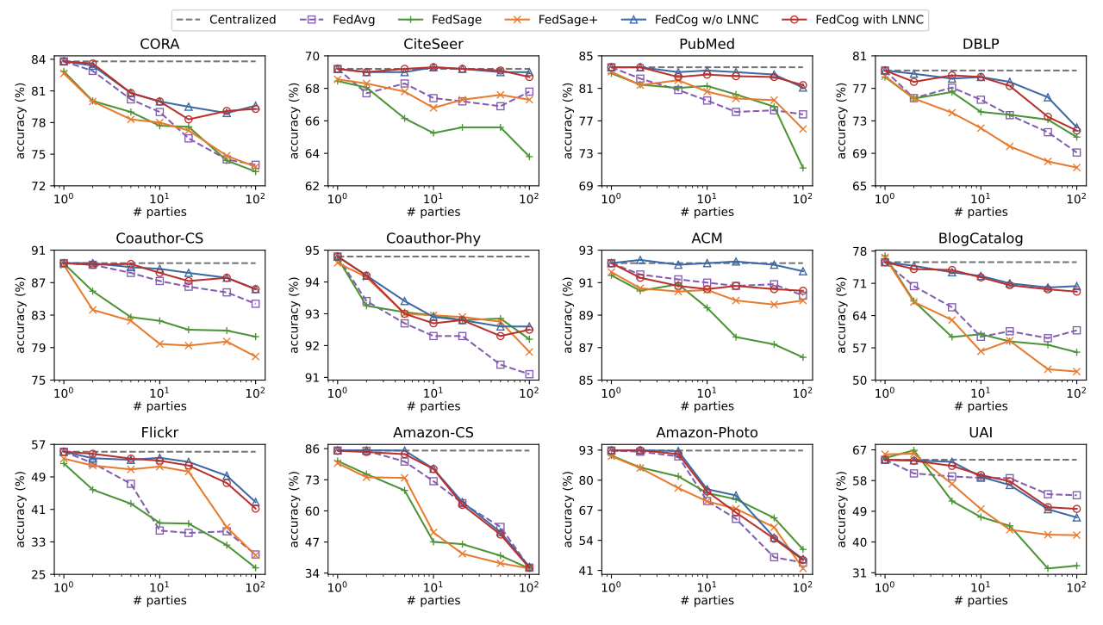
Experiment Results
Fig: Node classification accuracy when the global graphs are partitioned by METIS.
CPS Computational Learning Laboratory
28

Slide 29
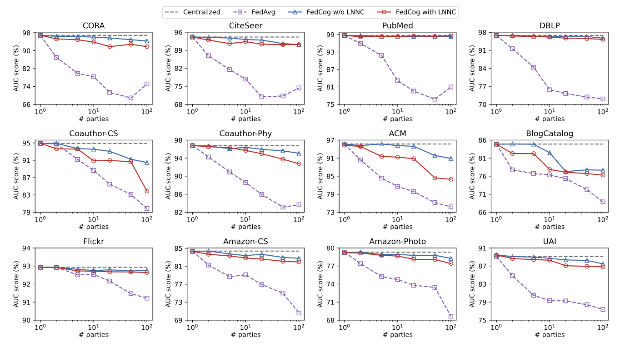
Experiment Results
Fig: AUC scores of link prediction tasks when the global graphs are partitioned by K-Means.
CPS Computational Learning Laboratory
29

Slide 30
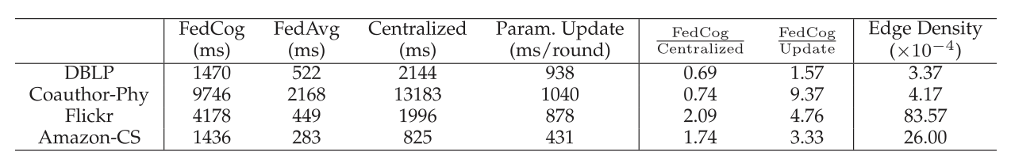
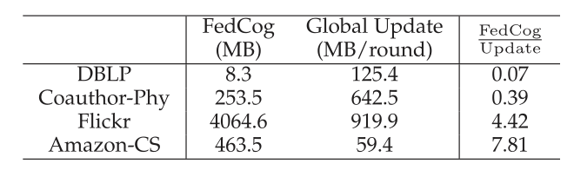
Experiment Results
Table: Run-times on 100 Fl Parties
Table: Communication Costs On 100 Fl Parties
CPS Computational Learning Laboratory
30

Slide 31
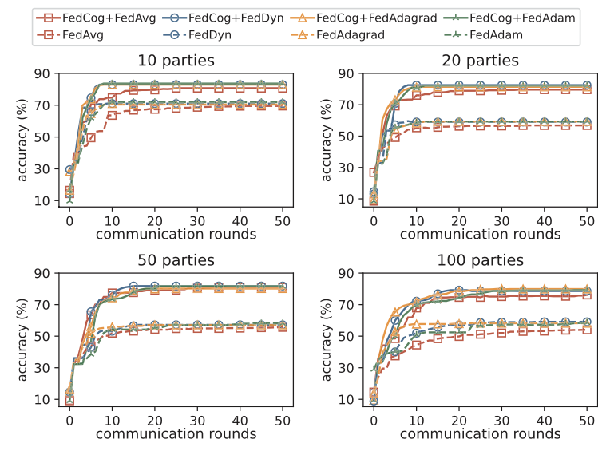
Experiment Results
Fig: Node classification accuracy on CORA dataset partitioned into {10, 20, 50, 100} parts with K-Means. Solid lines show the results of FedCog, and dashed lines are for SGC without regard to coupled graphs.
CPS Computational Learning Laboratory
31

Slide 32
01
Problem Description
02
Method Design
03
Experiment Results
Contents
04
Future Work
CPS Computational Learning Laboratory
32

Slide 33
Future Work
In the future, the research group will work towards communication efficiency and privacy preservation strategies for more GNN models.
CPS Computational Learning Laboratory
33

Slide 34
Modeling in Federated Graph Neural Networks: Overview and Techniques
①
②
③
Handling distributed coupled graphs while ensuring privacy and security.
Decentralized Graph Data Processing
Addressing domain heterogeneity with clustering and graph networks.
Sharing structural knowledge to handle non-IID graph data
Domain-aware Federated Learning
⑤
④
Improving model performance with global self-supervision.
Reducing overhead and privacy risks with intelligent graph sampling
Cross-client Knowledge Sharing
Global Knowledge Integration
CPS Computational Learning Laboratory
34

Slide 35
Paper 2
Cluster-driven Graph Federated Learning over Multiple Domains
Debora Caldarola, Massimiliano Mancini, Fabio Galasso, Marco Ciccone, Emanuele Rodola, and Barbara Caputo
Publish Journal: IEEE/CVF Conference on Computer Vision and Pattern Recognition (CVPR) Workshops, 2021
Published Time: 2021
CPS Computational Learning Laboratory
35

Slide 36
01
Problem Description
02
Method Design
03
Experiment Results
Contents
04
Conclusion
CPS Computational Learning Laboratory
36

Slide 37
01
Problem Description
02
Method Design
03
Experiment Results
Contents
04
Conclusion
CPS Computational Learning Laboratory
37

Slide 38
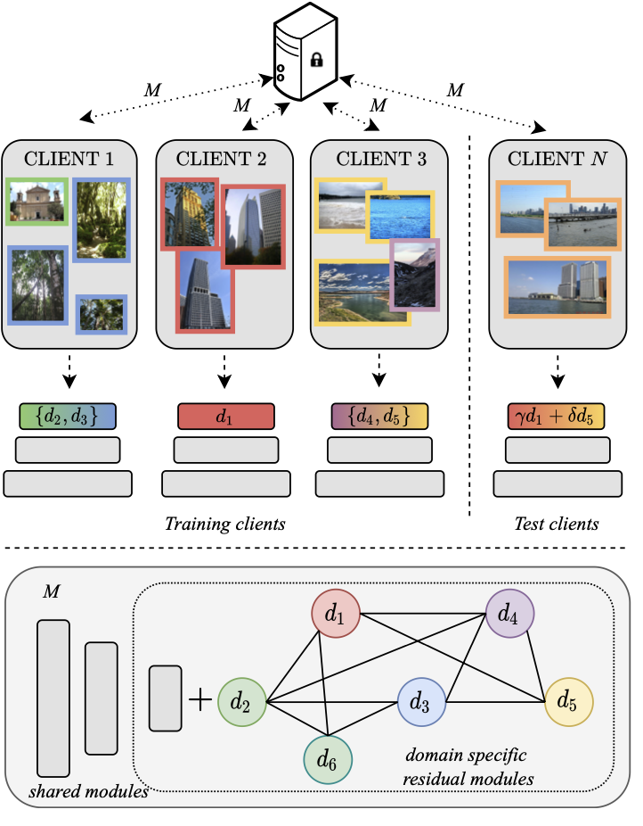
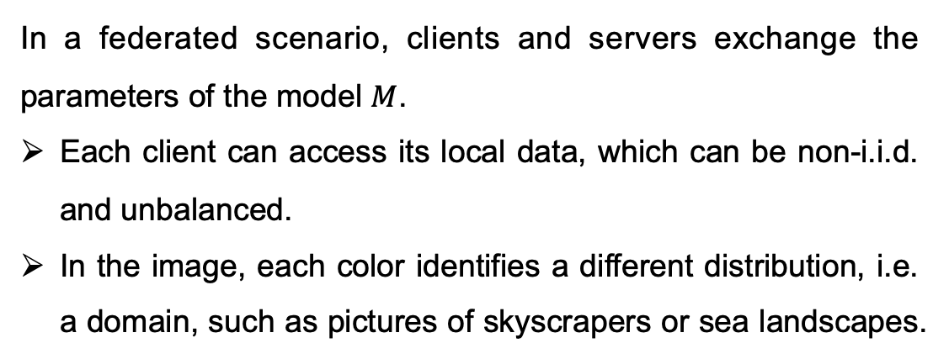
Problem Description
In a federated scenario, clients and servers exchange the parameters of the model $M$.
Each client can access its local data, which can be non-i.i.d. and unbalanced.
In the image, each color identifies a different distribution, i.e. a domain, such as pictures of skyscrapers or sea landscapes.
Fig: FedCG
CPS Computational Learning Laboratory
38

Slide 39
Problem Description
Federated Learning (FL): A central model is trained using data stored on multiple client devices. The server does not have direct access to raw data but only to the local updates of the model parameters from each client.
Statistical Heterogeneity: In federated learning, clients have different data distributions (domains), which may be non-identically distributed and unbalanced. This heterogeneity violates the i.i.d. (independent and identically distributed) assumptions in traditional learning.
Clustering in FL: Clustering clients can reduce heterogeneity by grouping similar domains. However, this approach limits each cluster model from benefiting from the data and supervision available in other clusters.
CPS Computational Learning Laboratory
39

Slide 40
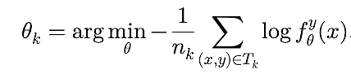
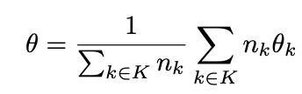
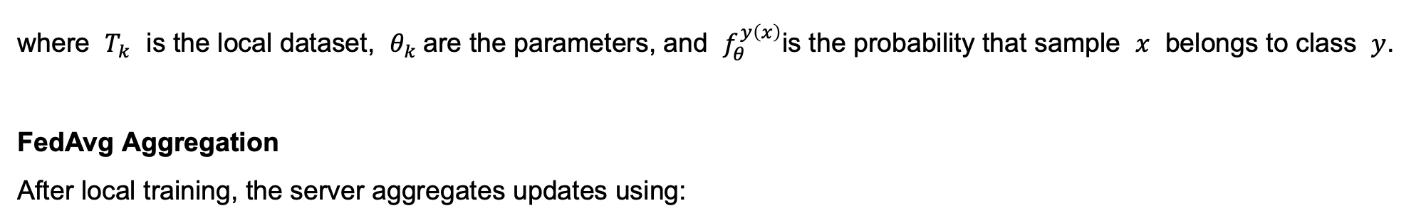
Problem Description
Objective Function
Each client k minimizes its local objective function:
where $T_{k}$ is the local dataset, $θ_{k}$are the parameters, and $f_{θ}^{y\left(x\right)}$is the probability that sample $x$ belongs to class $y$.
FedAvg Aggregation
After local training, the server aggregates updates using:
where $K$ is the set of participating clients in the current communication round.
CPS Computational Learning Laboratory
40

Slide 41
01
Problem Description
02
Method Design
03
Experiment Results
Contents
04
Conclusion
CPS Computational Learning Laboratory
41

Slide 42
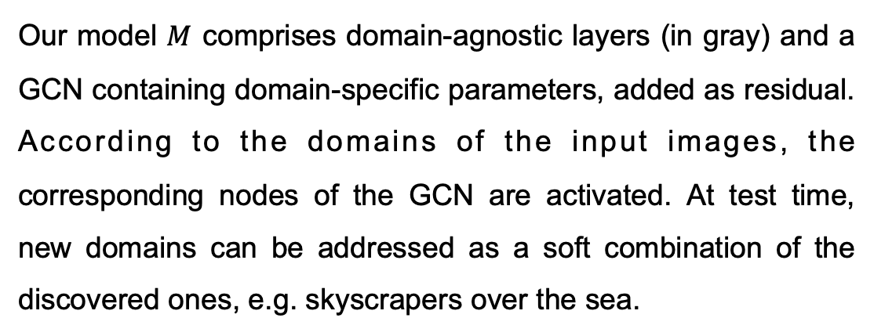
Method Design
Cluster-driven Graph Federated Learning (FedCG)
Our model $M$ comprises domain-agnostic layers (in gray) and a GCN containing domain-specific parameters, added as residual. According to the domains of the input images, the corresponding nodes of the GCN are activated. At test time, new domains can be addressed as a soft combination of the discovered ones, e.g. skyscrapers over the sea.
Fig: FedCG
CPS Computational Learning Laboratory
42

Slide 43
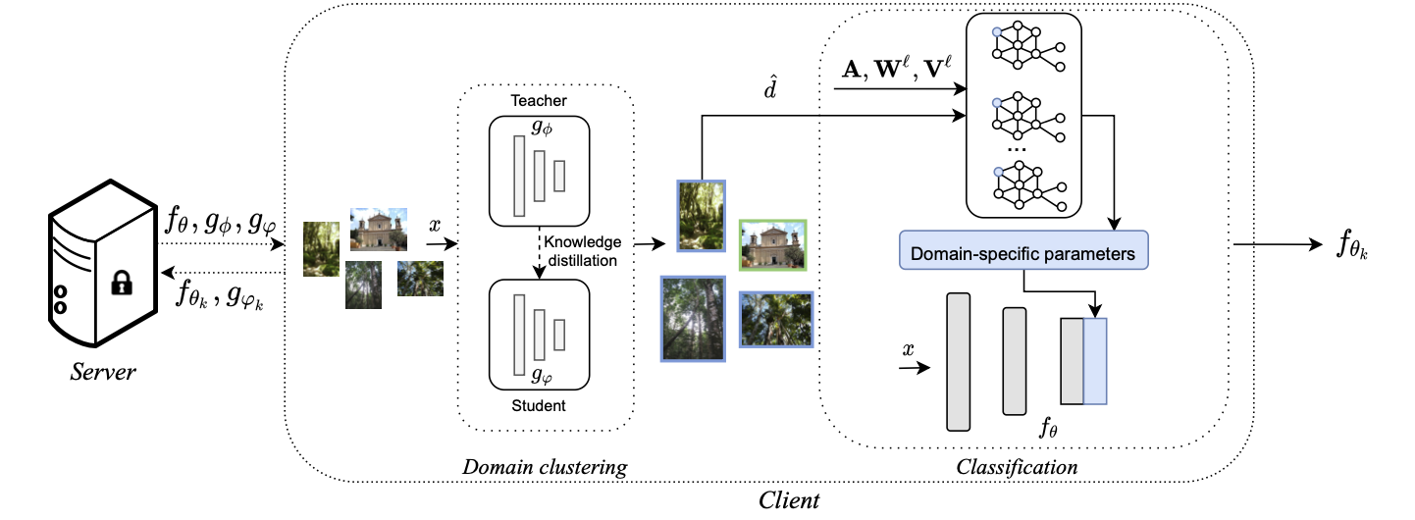
Method Design
Cluster-driven Graph Federated Learning (FedCG)
Clustering for Domain Identification: Identifies the domains in a federated setting using an FL-compliant clustering approach, creating domain-specific modules (residual branches) for each domain.
Graph Convolutional Networks (GCNs) for Knowledge Sharing: Uses GCNs to connect these domain-specific modules during training, allowing for interactions among domains and enabling knowledge sharing.
Soft Domain Assignment: At test time, it handles unseen domains using soft assignment scores.
CPS Computational Learning Laboratory
43

Slide 44
Method Design
The server sends the model $f_{θ}$ to the clients selected for the federated round, together with the teacher $g_{φ}$ and student $g_{φ}$domain classifiers.
CPS Computational Learning Laboratory
44

Slide 45
Method Design
On the client side, the domain classifier clusters the local data $x$, producing as output the domain of belonging $\overset{ˆ}{d}$ of each image
CPS Computational Learning Laboratory
45

Slide 46
Method Design
At training time, the hard label $\overset{ˆ}{d}$ is predicted by $g_{φ}$and is used as input to train $g_{φ}$through a process based on knowledge distillation.
CPS Computational Learning Laboratory
46

Slide 47
Method Design
At test time, $\overset{ˆ}{d}$ is given by $g_{φ}$ and is a weighted combination of the discovered domains
CPS Computational Learning Laboratory
47

Slide 48
Method Design
FedCG clusters data into different domains using a teacher-student classifier within a federated learning setting. This clustering is iterative and can generalize to unseen domains during testing through a soft-assignment mechanism.
CPS Computational Learning Laboratory
48

Slide 49
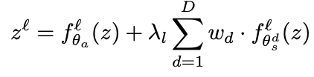
Method Design
Soft Domain Weighting
For each identified domain, specific parameters (domain-specific components) are introduced as residuals to the model:
where $z^{ℓ}$is the output of layer $ℓ$, $f_{θ}^{ℓ}$is the domain-agnostic function, $λ_{ℓ}$balances the domain-specific influence, and $w_{d}$ is the weight for each domain.
CPS Computational Learning Laboratory
49

Slide 50
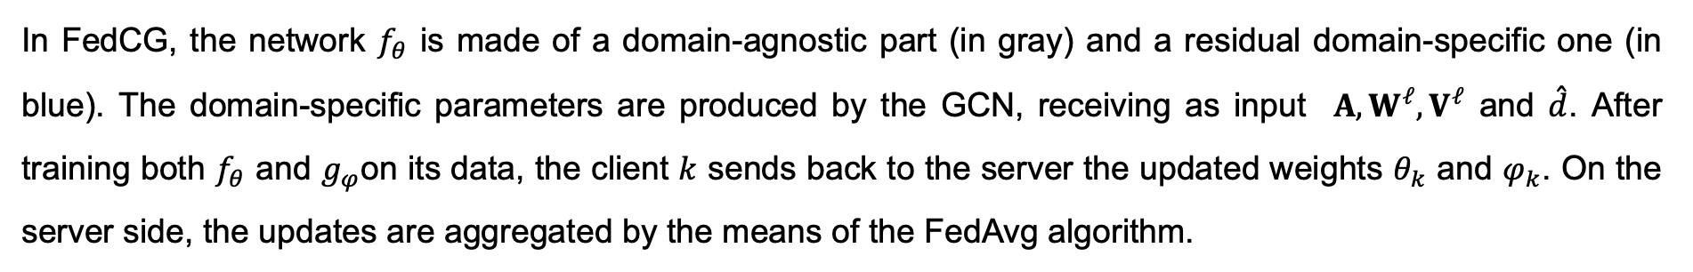
Method Design
In FedCG, the network $f_{θ}$ is made of a domain-agnostic part (in gray) and a residual domain-specific one (in blue). The domain-specific parameters are produced by the GCN, receiving as input $A,W^{𝓁},V^{𝓁}$ and $\overset{ˆ}{d}$. After training both $f_{θ}$ and $g_{φ}$on its data, the client $k$ sends back to the server the updated weights $θ_{k}$ and $φ_{k}$. On the server side, the updates are aggregated by the means of the FedAvg algorithm.
CPS Computational Learning Laboratory
50

Slide 51
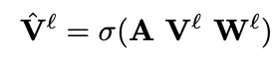
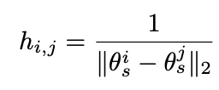
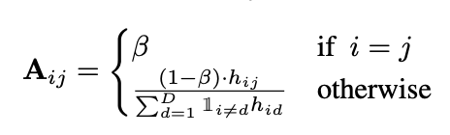
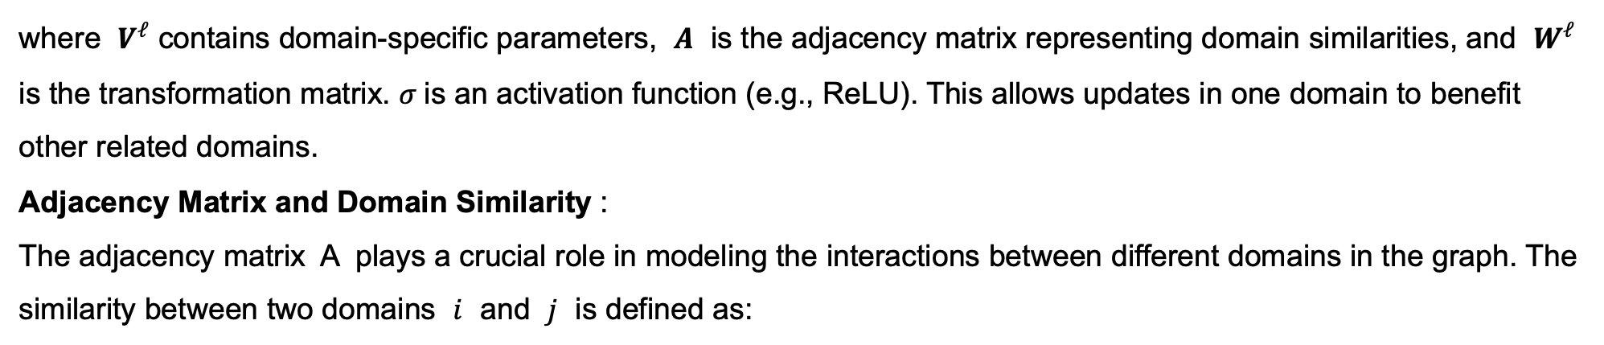
Method Design
Knowledge Sharing through GCN
FedCG uses a GCN to connect domain-specific modules, facilitating knowledge sharing among different domains:
where $V^{ℓ}$ contains domain-specific parameters, $A$ is the adjacency matrix representing domain similarities, and $W^{ℓ}$ is the transformation matrix. $σ$is an activation function (e.g., ReLU). This allows updates in one domain to benefit other related domains.
Adjacency Matrix and Domain Similarity :
The adjacency matrix A plays a crucial role in modeling the interactions between different domains in the graph. The similarity between two domains $i$ and $j$ is defined as:
where $β$is a hyperparameter that controls the self-connection weight of each domain.
CPS Computational Learning Laboratory
51

Slide 52
01
Problem Description
02
Method Design
03
Experiment Results
Contents
04
Conclusion
CPS Computational Learning Laboratory
52

Slide 53
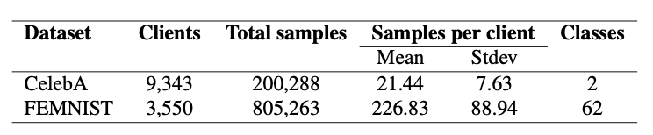
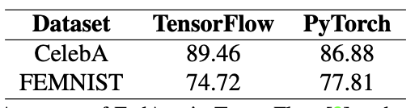
Experiment Results
Table: Datasets Statistics
Table: Accuracy of FedAvg in TensorFlow and our version implemented in PyTorch.
CPS Computational Learning Laboratory
53

Slide 54
Experiment Results
Table: Datasets Statistics
Table: Accuracy of FedAvg in TensorFlow and our version implemented in PyTorch.
CPS Computational Learning Laboratory
54

Slide 55

Experiment Results
Table: Ablation studies on CelebA dataset with N = 32 domains extracted from images meta-data. A is the adjacency matrix that weights the domain contributions: the symbols (eye, U, H) respectively stand for identity, uniform, and weighted (with inverse Hamming distance) matrices. W is the weight projection matrix and ReLU is the chosen non-linear activation.
CPS Computational Learning Laboratory
55

Slide 56

Experiment Results
Table: Ablation studies on CelebA dataset with domains given by a priori knowledge or online clustering procedures. In the A init column, “eye” stands for identity matrix and “rand” for random. The third column specifies the clustering, i.e. clusters generated with K-means or the teacher-student classifier (“Clf”).
CPS Computational Learning Laboratory
56

Slide 57

Experiment Results
Table: Comparison with the state of the art on CelebA and FEMNIST. We separate the methods according to their setting.
CPS Computational Learning Laboratory
57

Slide 58
01
Problem Description
02
Method Design
03
Experiment Results
Contents
04
Conclusion
CPS Computational Learning Laboratory
58

Slide 59
Conclusion
FedCG Overview: Introduced FedCG, the first cluster-driven approach for addressing statistical heterogeneity in federated learning using Graph Convolutional Networks (GCNs).
Iterative Clustering: Utilized a teacher-student classifier for iterative clustering to identify different data distributions (domains) and assign domain-specific parameters.
Domain Interactions: Connected domain-specific parameters through a GCN to facilitate knowledge sharing and interactions between domains.
Handling Unseen Domains: The model adapts to new, unseen input distributions during testing using domain soft-assignment scores.
CPS Computational Learning Laboratory
59

Slide 60
Modeling in Federated Graph Neural Networks: Overview and Techniques
①
②
③
Handling distributed coupled graphs while ensuring privacy and security.
Decentralized Graph Data Processing
Addressing domain heterogeneity with clustering and graph networks.
Sharing structural knowledge to handle non-IID graph data
Domain-aware Federated Learning
⑤
④
Improving model performance with global self-supervision.
Reducing overhead and privacy risks with intelligent graph sampling
Cross-client Knowledge Sharing
Global Knowledge Integration
CPS Computational Learning Laboratory
60

Slide 61
Paper 3
Federated Learning on Non-IID Graphs via Structural Knowledge Sharing
Yue Tan, Yixin Liu, Guodong Long, Jing Jiang, Qinghua Lu, and Chengqi Zhang
Publish Journal: AAAI Conference on Artificial Intelligence, 2023
Published Time: 26 June 2023
CPS Computational Learning Laboratory
61

Slide 62
01
Problem Description
02
Method Design
03
Experiment Results
Contents
04
Conclusion
CPS Computational Learning Laboratory
62

Slide 63
01
Problem Description
02
Method Design
03
Experiment Results
Contents
04
Conclusion
CPS Computational Learning Laboratory
63

Slide 64
Problem Description
Existing Federated Learning (FL) methods struggle to handle non-IID graph data, resulting in unstable training and performance drops.
Conventional GNNs implicitly encode structure information along with features, which leads to difficulties in sharing structural knowledge across diverse domains.
CPS Computational Learning Laboratory
64

Slide 65

Problem Description
(a) Performance comparison of local training and FL/FGL in three cross-dataset/domain non-IID settings.
(b) The heatmap of Jensen-Shannon divergence of degree distributions among six real-world graph datasets from different domains and random graphs.
CPS Computational Learning Laboratory
65

Slide 66
01
Problem Description
02
Method Design
03
Experiment Results
Contents
04
Conclusion
CPS Computational Learning Laboratory
66

Slide 67
Method Design
The proposed method in the paper is FedStar, a federated graph learning framework that shares structural knowledge across clients while preserving personalized, feature-based learning locally. The method is designed to address the challenges of non-IID graph data in federated learning by decoupling structural and feature-based information.
CPS Computational Learning Laboratory
67

Slide 68

Method Design
An overview of the local GNN architecture in our proposed FedStar. Blue boxes correspond to the models that are trained locally, and personalized for each client. Orange boxes correspond to the models that are aggregated at the server, with knowledge shared across clients.
CPS Computational Learning Laboratory
68

Slide 69
Method Design
An illustration of the data distribution and model aggregation scheme.
CPS Computational Learning Laboratory
69

Slide 70
Method Design
Structure Embedding Initialization
In traditional GNNs, structural information (e.g., node degrees) is encoded along with feature information. However, in non-IID settings, features are often heterogeneous across domains. Structure embeddings capture both local and global structural patterns.
CPS Computational Learning Laboratory
70

Slide 71
Method Design
Structure Embedding Initialization
FedStar introduces degree-based structure embedding as a separate representation to encodes the local structural knowledge based on node degrees using one-hot encoding:
where $d_{v}$ is the degree of node $v$, $I$ is an identity function, and $k_{1}$ is the dimension of the DSE.
CPS Computational Learning Laboratory
71

Slide 72


Method Design
Structure Embedding Initialization
To capture global structural knowledge, FedStar introduce a random walk-based structure embedding (RWSE)
where $T = A D^{−1}$is the random walk transition matrix, $A$ is the adjacency matrix, $D$ is the degree matrix, and $k_{2}$is the embedding dimension. The $k$ -th element of $s_{v}^{RWSE}$represents the landing probability of node $v$ after a $k$ -step random walk.
CPS Computational Learning Laboratory
72

Slide 73

Method Design
Structure Embedding Initialization
Finally, the structure embedding can be obtained by concatenating both DSE and RWSE and represented as
CPS Computational Learning Laboratory
73

Slide 74

Method Design
2. Feature-Structure Decoupled GNN
Learn both structural and feature-based knowledge separately using a dual-channel GNN.
Dual-Channel Architecture:
Feature Encoder: Learns from the raw node features $x_{v}$and generates hidden embeddings by aggregating neighboring attributive and structural information.
Structure Encoder: Operates solely on the structure embeddings $s_{v}$ to propagate structural knowledge over the graph, independently from feature information.
CPS Computational Learning Laboratory
74

Slide 75

Method Design
2. Feature-Structure Decoupled GNN
Input Embedding: Transform node features $x_{v}$ and structure embeddings $s_{v}$ into initial hidden embeddings $h_{v}^{\left(0\right)}$ (feature) and $g_{v}^{\left(0\right)}$(structure) using parallel linear layers.
CPS Computational Learning Laboratory
75

Slide 76


Method Design
2. Feature-Structure Decoupled GNN
Propagation in L-layers: At each layer $l$, the structure encoder $f_{g}^{\left(l\right)}$updates the hidden structural embeddings $g_{v}^{\left(l\right)}$based on its previous layer outputs:
where $g_{v}^{\left(l\right)}$ focuses on structural information aggregation.
CPS Computational Learning Laboratory
76

Slide 77

Method Design
2. Feature-Structure Decoupled GNN
Propagation in L-layers: The feature encoder then combines both feature and structural embeddings, facilitating the generation of node representations enriched with structure-aware information.
CPS Computational Learning Laboratory
77

Slide 78


Method Design
2. Feature-Structure Decoupled GNN
Objective Function: The local training at the $m$ -th client optimizes the model parameters $w_{h, m}$(feature encoder and classifier) and $w_{g, m}$ (structure encoder) using:
where $L_{m}\left(w_{m}; D_{m}\right)$ is the local cross-entropy loss on the client’s dataset $D_{m}$ , and $w_{m}= \{w_{h, m}, w_{g m}\}$represents the complete set of learnable parameters.
CPS Computational Learning Laboratory
78

Slide 79


Method Design
3. Structural Knowledge Sharing in Federated Learning
Clients send the learned structure encoder parameters $w_{g ,m}$to the server. The server aggregates these parameters:
where $\left|D_{m}\right|$is the number of graphs in the client m’s local dataset, and $N$is the total number of graphs across all clients.
The server returns the aggregated structure encoder $\overline{w_{g}}$ to the clients for the next round of training, facilitating global sharing of structural knowledge while allowing local personalization.
CPS Computational Learning Laboratory
79

Slide 80
01
Problem Description
02
Method Design
03
Experiment Results
Contents
04
Conclusion
CPS Computational Learning Laboratory
80

Slide 81

Experiment Results
Table: Performance on different federated graph classification tasks. In each task/setting, there are multiple datasets owned by different clients. These datasets come from one or multiple domains.
CPS Computational Learning Laboratory
81

Slide 82

Experiment Results
Table: Ablation studies on the effects of sharing mechanisms. FE and SE stand for and structure encoder, respectively. FE: feature encoder; All: all learnable parameters; DC: decoupling.
CPS Computational Learning Laboratory
82

Slide 83

Experiment Results
Fig: Test accuracy curves of our proposed FedStar and five FL/FGL methods along the communication rounds. Each subfigure corresponds to a specific cross-dataset (a) or cross-domain (b,c,d) non-IID settings.
CPS Computational Learning Laboratory
83

Slide 84


Experiment Results
Table: An ablation study on varying structure embeddings.
Table: The performance on cross-dataset non-IID setting (SM), with varying local epochs.
CPS Computational Learning Laboratory
84

Slide 85

Experiment Results
Fig: The performance on cross-dataset non-IID setting (SM), with varying numbers of clients.
CPS Computational Learning Laboratory
85

Slide 86
01
Problem Description
02
Method Design
03
Experiment Results
Contents
04
Conclusion
CPS Computational Learning Laboratory
86

Slide 87
Conclusion
Decoupling Feature and Structure Learning: FedStar separates feature-based and structure-based learning using a feature-structure decoupled GNN, allowing clients to learn personalized feature representations while sharing structural information globally.
Structural Knowledge Sharing: The framework extracts structure embeddings to represent the intrinsic structural properties of graphs and shares them across clients to facilitate global knowledge transfer without revealing sensitive feature-based information.
Local Training and Global Aggregation: Each client trains its model locally using the feature-structure decoupled GNN and shares only the structure encoder’s parameters with the central server. The server aggregates these parameters to form a global structural model.
CPS Computational Learning Laboratory
87

Slide 88
Modeling in Federated Graph Neural Networks: Overview and Techniques
①
②
③
Handling distributed coupled graphs while ensuring privacy and security.
Decentralized Graph Data Processing
Addressing domain heterogeneity with clustering and graph networks.
Sharing structural knowledge to handle non-IID graph data
Domain-aware Federated Learning
⑤
④
Improving model performance with global self-supervision.
Reducing overhead and privacy risks with intelligent graph sampling
Cross-client Knowledge Sharing
Global Knowledge Integration
CPS Computational Learning Laboratory
88

Slide 89
Paper 4
FedGraph: Federated Graph Learning With Intelligent Sampling
Fahao Chen, Peng Li, Toshiaki Miyazaki, and Celimuge Wu
Publish Journal: IEEE Transactions on Parallel and Distributed Systems
Published Time: 8 November 2023
IF: 5.4
CPS Computational Learning Laboratory
89

Slide 90
01
Problem Description
02
Method Design
03
Experiment Results
Contents
04
Conclusion
CPS Computational Learning Laboratory
90

Slide 91
01
Problem Description
02
Method Design
03
Experiment Results
Contents
04
Conclusion
CPS Computational Learning Laboratory
91

Slide 92
Problem Description
Current FL Limitations: Most existing federated learning research focuses on Convolutional Neural Networks (CNNs) for image and voice data, but they struggle with graph data, which are common in applications like social networks and biological systems.
Graph Data in Federated Learning: Each client in federated graph learning holds a subgraph containing private node features. Direct data sharing among clients is not allowed, leading to challenges in graph learning.
CPS Computational Learning Laboratory
92

Slide 93
Problem Description
Challenge
Privacy Leakage: Training Graph Convolutional Networks (GCNs) typically requires node feature sharing among clients, risking privacy.
High Training Overhead: The large size of graphs (e.g., social networks) results in computational challenges during GCN training.
CPS Computational Learning Laboratory
93

Slide 94
01
Problem Description
02
Method Design
03
Experiment Results
Contents
04
Conclusion
CPS Computational Learning Laboratory
94

Slide 95

Method Design
The proposed method, FedGraph, addresses the challenges of federated graph learning by incorporating cross-client graph convolution and an intelligent sampling algorithm based on deep reinforcement learning (DRL).
Fig: The FedGraph architecture.
CPS Computational Learning Laboratory
95

Slide 96

Method Design
Each client $i$ maintains a local graph $G_{i}$. During the training, nodes in the mini-batch (nodes in red) aggregate neighbors' embeddings to generate the next layer's embeddings, denoted by red arrows. When training completes, each client $i$ uploads its local model weights $W_{i}$ to the parameter server. Finally, the parameter server aggregates all local model weights to the updated global model $\overset{‾}{W}$ and sends it back to all clients.
Fig: The FedGraph architecture.
CPS Computational Learning Laboratory
96

Slide 97

Method Design
Fig: System design.
The parameter server contains three main modules.
The deep deterministic policy gradient (DDPG) based sampling algorithm generates sampling policies for all clients. A model aggregator collects local feature weights trained by clients and aggregates them to generate new global feature weights for next-round training.
The communication module is designed for message exchanges between the parameter server and clients. This communication module is realized by gRPC APIs, which are based on TCP communication protocol.
Each client has a module of GCN construction, responsible for creating a GCN model according to the sampling policy.
CPS Computational Learning Laboratory
97

Slide 98

Method Design
Local GCN Training by Clients
CPS Computational Learning Laboratory
98

Slide 99




Method Design
Local GCN Training by Clients: GCN Construction
The GCN model $G_{i}$of client $i$ is constructed using the ModelConstruct() function, which samples a subset of nodes based on a predefined policy $P_{i}$ .
where $κ_{i}$denotes the minibatch size, and $\left\{p_{i}^{\left(1\right)},p_{i}^{\left(2\right)},…,p_{i}^{\left(L−1\right)}\right\}$ are neighbor sampling probabilities of $L−1$layers, respectively.
CPS Computational Learning Laboratory
99

Slide 100

Method Design
Local GCN Training by Clients: GCN Construction
Then, FedGraph iteratively constructs other GCN layers in a backward direction. For each node $v$ in the $(l+1)$ th layer, we randomly select a subset $N_{i}^{\left(l\right)}\left(v\right)$of its neighbors into the l th layer with a probability $p_{i}^{\left(l\right)}$.
CPS Computational Learning Laboratory
100

Slide 101


Method Design
Local GCN Training by Clients: GCN Construction
FedGraph creates a matrix ${\tilde{Q}}_{i}^{\left(l\right)}$ to replace $Q$ in (7), where $V_{i}$ $(v)$ denotes the set of neighbors of node v in the original graph $G_{i}$. The matrix ${\tilde{Q}}_{i}^{\left(l\right)}$describes the updated adjacent relation after sampling, and it will be used for feature aggregation later.
All sampled nodes in the l th layer are maintained in set $V_{i}^{\left(l\right)}$, as shown in the final line.
CPS Computational Learning Laboratory
101

Slide 102

Method Design
Global Parameter Update:
After local training, clients upload their updated feature weights to the central server.
CPS Computational Learning Laboratory
102

Slide 103

Method Design
Intelligent Graph Sampling Based on DRL
Fig: Illustration of DDPG-based sampling.
FedGraph uses a Deep Reinforcement Learning (DRL)-based algorithm to optimize the graph sampling process, aiming to balance computational cost and model accuracy. The server generates sampling policies for all clients using the DDPG (Deep Deterministic Policy Gradient) algorithm.
CPS Computational Learning Laboratory
103

Slide 104



Method Design
State Space: The state $s_{t}$ represents the current information of the graph at time $t$, which includes node features, degrees, and other graph statistics.
$$s\left[t\right]= \{̅\overline{W}\left[t\right], W_{1}\left[t\right], W_{2}\left[t\right], …, W_{\left|C\right|}\left[t\right]$$
Action: The action $a_{t}$ defines the number of nodes to be sampled for training in each round, controlling the computational cost and model accuracy. The action space is denoted by $𝒜$
$$a\left[t\right]= \{P_{1}\left[t\right], P_{2}\left[t\right], …, P_{\left|C\right|}\left[t\right]$$
Reward: The reward $r_{t}$ is designed to maximize model accuracy while minimizing computational cost:
Fig: Illustration of DDPG-based sampling.
where $Ω$ is a base of the exponential function, $λ\left[t\right]$is the training accuracy, $Λ$ is the target accuracy, $δ[t]$is the training duration, and $α$, $β$are constants to balance accuracy and time cost.
CPS Computational Learning Laboratory
104

Slide 105



Method Design
The policy $π_{θ}: S →A$is parameterized by $θ$. Given a state $s[t]$, the algorithm outputs a deterministic action $a[t]$. The objective is to maximize the expected cumulative discounted reward:
where $R\left[t\right]=\sum_{k=0}^{∞}{γ^{k}r\left[t+k\right]}$ is the cumulative discounted reward.
Fig: Illustration of DDPG-based sampling.
CPS Computational Learning Laboratory
105

Slide 106


Method Design
An actor network $μ\left(s | θ_{μ}\right)$predicts deterministic actions (sampling policies), and a critic network $q\left(s, a | θ_{q}\right)$estimates the action-value function.
Target Networks: Copies of the actor and critic networks are maintained to update the original networks. These target networks are denoted as $\tilde{μ}\left(s | {\tilde{θ}}_{μ}\right)$
Replay Buffer: The algorithm maintains a replay buffer that stores historical transitions $(s[t], a[t], r[t], s[t+1]$) . During training, a mini-batch of transitions is sampled from this buffer to update the networks.
106
CPS Computational Learning Laboratory

Slide 107





Method Design
The critic network is updated by minimizing the loss:
where $q^{target}= r_{k}+ γ\tilde{q}(s^{′}[k], \tilde{μ}(s^{′}[k]| {\tilde{θ}}_{μ})|{\tilde{θ}}_{q})$. The parameters of the critic network are updated as:
where $η_{q}$is the learning rate. Then we update the actor network as follows:
where $η_{μ}$ is the learning rate of the actor network.
107
CPS Computational Learning Laboratory

Slide 108
01
Problem Description
02
Method Design
03
Experiment Results
Contents
04
Conclusion
CPS Computational Learning Laboratory
108

Slide 109

Experiment Results
Table: Graph Data
CPS Computational Learning Laboratory
109

Slide 110

Experiment Results
Fig: Cumulative discounted returns of FedGraph.
CPS Computational Learning Laboratory
110

Slide 111

Experiment Results
Fig: Accuracy convergence of different sampling schemes with 20 clients. Note that, FastGCN completes the training with less time as it samples fewer nodes for training. However, it has poor performance in all datasets.
CPS Computational Learning Laboratory
111

Slide 112

Experiment Results
Fig: Accuracy convergence of different sampling schemes with 50 clients.
CPS Computational Learning Laboratory
112

Slide 113

Experiment Results
Fig: The convergence time under different levels of graph heterogeneity.
CPS Computational Learning Laboratory
113

Slide 114

Experiment Results
Fig: Convergence of FedGraph and FedGraph_nonShare. FedGraph_nonShare completes the training with less time as it ignores lots of connections in the local training. However, it has a poor convergence.
CPS Computational Learning Laboratory
114

Slide 115

Experiment Results
Fig: Training accuracy and time under different GCN depths.
CPS Computational Learning Laboratory
115

Slide 116

Experiment Results
Fig: Accuracy convergence of different sampling schemes on non-iid data.
CPS Computational Learning Laboratory
116

Slide 117
01
Problem Description
02
Method Design
03
Experiment Results
Contents
04
Conclusion
CPS Computational Learning Laboratory
117

Slide 118
Conclusion
Introduces a Cross-Client Graph Convolution mechanism that allows clients to collaboratively learn GCNs without directly sharing sensitive data.
Proposes a Deep Reinforcement Learning (DRL)-based intelligent sampling algorithm to optimize the selection of nodes for training, balancing accuracy and computational cost.
Suggests exploring more sophisticated sampling policies and incorporating additional privacy-preserving mechanisms into the federated graph learning process.
CPS Computational Learning Laboratory
118

Slide 119
Modeling in Federated Graph Neural Networks: Overview and Techniques
①
②
③
Handling distributed coupled graphs while ensuring privacy and security.
Decentralized Graph Data Processing
Addressing domain heterogeneity with clustering and graph networks.
Sharing structural knowledge to handle non-IID graph data
Domain-aware Federated Learning
⑤
④
Improving model performance with global self-supervision.
Reducing overhead and privacy risks with intelligent graph sampling
Cross-client Knowledge Sharing
Global Knowledge Integration
CPS Computational Learning Laboratory
119

Slide 120
Paper 5
FedGL: Federated graph learning framework with global
self-supervision
ChuanChen, ZiyueXu, WeiboHu, ZibinZheng, and JieZhang
Publish Journal: Information Sciences
Published Time: 5 December 2023
IF: 6.8
CPS Computational Learning Laboratory
120

Slide 121
01
Problem Description
02
Method Design
03
Experiment Results
Contents
04
Future Work
CPS Computational Learning Laboratory
121

Slide 122
01
Problem Description
02
Method Design
03
Experiment Results
Contents
04
Future Work
CPS Computational Learning Laboratory
122

Slide 123
Problem Description
Heterogeneity: Graph data across different clients are often non-IID (Non-Independent and Identically Distributed), resulting in large discrepancies between locally trained models and a decline in global model performance.
Complementarity: Overlapping nodes in different clients contain complementary information. However, due to the inability to share data, the graph structures on each client remain incomplete.
CPS Computational Learning Laboratory
123

Slide 124

Problem Description
Heterogeneity and complementarity in graph data among diﬀerent clients is common in federated learning scenarios. As an example, Client A/B/C has 9/5/4 nodes, 9/5/3 edges, and 4/2/1 labels, respectively. The three clients vary in terms of the number of nodes, edges, and labels, and thus diﬀerence becomes more obvious on large-scale graphs in the real world. This is so-called heterogeneity.
On the other hand, there are overlapping nodes among diﬀerent clients. In client A, nodes 1, 2, and 3 are closely connected and have the same label a, while nodes 4 and 5 are disconnected with node 5 having no label. However, in client B, nodes 4 and 5 are connected sharing label a. Therefore, by combining information from Client B, client A can infer that nodes 4 and 5 should also be closely connected andpredicted to have label a. This is so-called complementarity.
CPS Computational Learning Laboratory
124

Slide 125
01
Problem Description
02
Method Design
03
Experiment Results
Contents
04
Future Work
CPS Computational Learning Laboratory
125

Slide 126
Method Design
Federated Graph Learning Framework (FedGL)
FedGL is a federated graph learning framework designed to collaboratively train high-quality graph models across distributed graph data while preserving data privacy. It introduces the concept of global self-supervision to address the heterogeneity and complementarity of graph data across multiple clients.
CPS Computational Learning Laboratory
126

Slide 127


Method Design
Federated Graph Learning Framework (FedGL)
Local Model Training
Each client trains a Graph Convolutional Network (GCN) model using its local graph data, which consists of an adjacency matrix $A_{k}$, a node feature matrix $X_{k}$, and a label matrix $Y_{k}$. The objective of each client is to produce model parameters $W_{k}$, node embeddings $H_{k}$, and prediction results $P_{k}$.
The clients then upload these parameters, embeddings, and predictions to the server.
Fig: The detailed framework of FedGL.
CPS Computational Learning Laboratory
127

Slide 128

Method Design
Federated Graph Learning Framework (FedGL)
$L_{GCN}$ is the loss function of graph convolutional network, and $L_{SSL}$ is the loss function of self-supervised learning. $a_{1},…,a_{K}$ is the aggregation weights. ${\overset{‾}{Y}}_{02}=1$ indicates that the discovered global pseudo label of node 1 is class 3.
Fig: The detailed framework of FedGL.
CPS Computational Learning Laboratory
128

Slide 129

Method Design
Federated Graph Learning Framework (FedGL)
Global Model Aggregation
The server aggregates the local model parameters $( W_{1}, W_{2}, …, W_{K})$to obtain the global model $\overline{W}$.
The aggregated global model $\overline{W}$is then distributed to each client for the next round of training.
Fig: The detailed framework of FedGL.
CPS Computational Learning Laboratory
129

Slide 130



Method Design
Federated Graph Learning Framework (FedGL)
Global Self-Supervision Discovery
he server aggregates the prediction results $( P_{1}, P_{2}, …, P_{K})$to obtain the global prediction result $\overline{P}$.
where $\frac{N_{k}}{M}$ is used as the fusion weight to measure the importance of the prediction results of the client 𝑘.
Fig: The detailed framework of FedGL.
CPS Computational Learning Laboratory
130

Slide 131


Method Design
Federated Graph Learning Framework (FedGL)
Global Pseudo Label: The server selects the highest probability class from the global prediction result P for each node as a pseudo label, forming a global pseudo label one-hot matrix $\overline{Y}$.
Fig: The detailed framework of FedGL.
CPS Computational Learning Laboratory
131

Slide 132


Method Design
Federated Graph Learning Framework (FedGL)
Global Pseudo Graph: The server aggregates the node embeddings $( H_{1}, H_{2}, …, H_{K})$and reconstructs the full adjacency matrix, obtaining the global pseudo graph $\overline{A}$.
where 𝜙(𝑥) =max(𝑥, 0).
Fig: The detailed framework of FedGL.
CPS Computational Learning Laboratory
132

Slide 133


Method Design
Federated Graph Learning Framework (FedGL)
Global Self-Supervision Utilization:
Clients receive the global pseudo labels $\overline{Y}$ and the global pseudo graph $\overline{A}$ from the server.
Training Enhancement: The pseudo labels enrich the training set with additional “real” labels, improving the local model’s performance. The pseudo graph complements the incomplete local graph structures.
Fig: The detailed framework of FedGL.
Fig: Example of global pseudo label $\overline{Y}$ projection to client 𝑘
CPS Computational Learning Laboratory
133

Slide 134



Method Design
Federated Graph Learning Framework (FedGL)
Global Self-Supervision Utilization:
Loss Function: The final loss function for each client $k$combines the GCN loss and self-supervised learning (SSL) loss:
where $α$controls the contribution of self-supervised learning, $V_{PL}$ represents the set of nodes with global pseudo labels.
Fig: The detailed framework of FedGL.
CPS Computational Learning Laboratory
134

Slide 135
01
Problem Description
02
Method Design
03
Experiment Results
Contents
04
Future Work
CPS Computational Learning Laboratory
135

Slide 136

Experiment Results
Table: Statistics of Datasets.
CPS Computational Learning Laboratory
136

Slide 137

Experiment Results
Table: Node Classification Accuracy under Fixed Split.
CPS Computational Learning Laboratory
137

Slide 138

Experiment Results
Table: Node classification accuracy under random split.
CPS Computational Learning Laboratory
138

Slide 139

Experiment Results
Fig: Visualization of node embedding learned by different methods on ACM.
CPS Computational Learning Laboratory
139

Slide 140

Experiment Results
Fig: The number of nodes and the proportion of training labels of each client (C1-C6) on different datasets.
CPS Computational Learning Laboratory
140

Slide 141


Experiment Results
Fig: The node degree distribution of each client (C1-C6) on different datasets.
Fig: The node classification accuracy of each client (C1-C6) on different datasets.
CPS Computational Learning Laboratory
141

Slide 142


Experiment Results
Table: Node classification accuracy under different client participation ratios per round.
Table: Node classification accuracy under different numbers of clients and data size. D1: [30%,40%,50%], D2: [20%,40%,60%], D3: [50%, 60%,70%, 80%], D4: [20%,40%,50%, 70%, 70%, 90%].
CPS Computational Learning Laboratory
142

Slide 143

Experiment Results
Table: Node classification accuracy under different overlapping node ratio between clients.
CPS Computational Learning Laboratory
143

Slide 144

Experiment Results
Fig: Node classification accuracy under different global pseudo graph coefficient $β$.
CPS Computational Learning Laboratory
144

Slide 145


Experiment Results
Table: Node classification accuracy under fixed split using FedProx.
Table: Wilcoxon signed-rank test p-value results including greater and two-sided (in parentheses) modes for node classification experiment under fixed split setting.
CPS Computational Learning Laboratory
145

Slide 146
01
Problem Description
02
Method Design
03
Experiment Results
Contents
04
Future Work
CPS Computational Learning Laboratory
146

Slide 147
Future Work
Suggests exploring more advanced self-supervised learning techniques and further enhancing privacy-preserving mechanisms in federated graph learning.
CPS Computational Learning Laboratory
147

Slide 148
Thank you for listening
Notes:
感谢老师同学观看，请各位老师同学批评指正

